Slide 1

C# Advanced – Class11
Trainer:
Assistant:
Code academy @ Skopje, 2019

Slide 2
Agenda
Serialization and Deserialization
Binary serialization
Xml serialization
Json serialization
Discussion on serializations

Slide 3
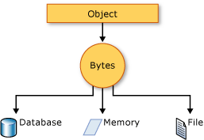
Serialization
Serialization is the process of converting an object into a stream of bytes to store the object or transmit it to memory, a database, or a file. Its main purpose is to save the state of an object in order to be able to recreate it when needed. The reverse process is called deserialization.

Slide 4
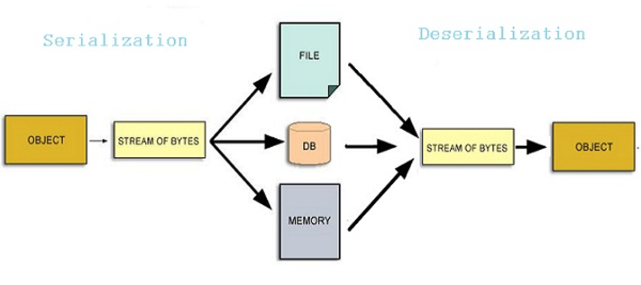
Deserialization
Deserialization is the opposite process of Serialization

Slide 5
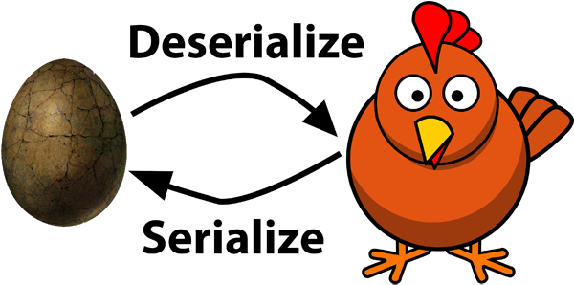
Serialize and Deserialize

Slide 6
Serialization
Serialization is the process of converting an object's state into information that can be stored for later retrieval or that can be sent to another system.
Binary serialization
Binary serialization allows single objects or complex models to be converted to binary streams, which may be stored in files or transported to other systems.
Xml serialization
With XML serialization, the public state of objects can be converted into an XML document. Such XML information is often stored on disk to persist data for later use, or is transported over a network or the Internet to send messages between computers.
Json serialization
Similar as the XML serialization, but more flexible and more efficient than the others.

Slide 7
Binary vs. XML vs. Json serialization
The binary serialization process uses classes from the System.Runtime.Serialization and System.Runtime.Serialization.Formatters.Binary namespaces. This gives a concise result and ensures that when the data is deserialized, the object structure is correctly reconstructed.
XML/Json serialization convert the state of objects into XML/Json. System.Xml.Serialization/Newtonsoft.Json namespaces. This allows the information to be deserialized into different data types, including into software that has been created using technologies other than the .NET framework. As XML/Json documents can be verbose, the serialized information can be larger than its binary equivalent. However, it is human-readable and, in appropriate scenarios, can be easily edited.
One important disadvantage of XML serialization is that private properties and fields are not extracted so cannot be recreated from the data. This is not the case at the Binary and Json serializations
Another disadvantage of the XML serialization is that the references are not encoded.
The [Serializable] attribute is not required for the XML/Json serialization, while it’s required for the Binary serialization.

Slide 8
Deserialization
The reversible process of the serialization is called Deserialization. There is method Deserialize() both to the binary and xml serializations.
Json has the DeserializeObject method
A commonly experienced problem is that the constructor for an object is not executed when data is deserialized.

Slide 9
Demos (without attributes in classes)
Binary serialization
Xml serialization
Json serialization

Slide 10
Discussion
FileStream vs. StreamWritter - https://stackoverflow.com/questions/4963667/filestream-vs-differences-streamwriter
Both, FileStream and StreamWriter can be used for writing
Both, FileStream and StreamReader can be used for reading

Slide 11
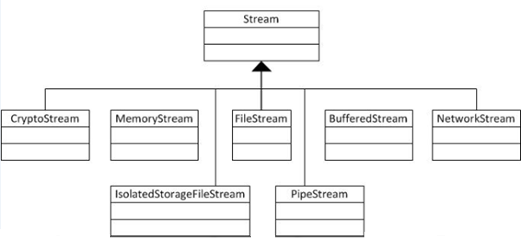
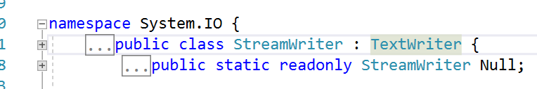
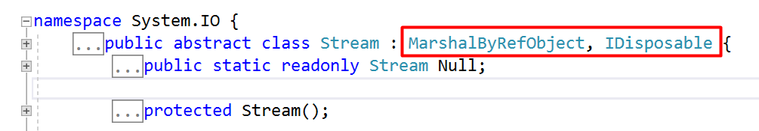
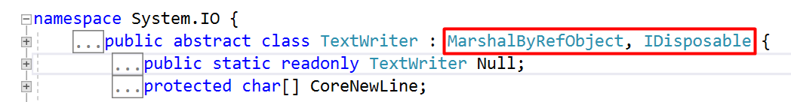
FileStream vs. StreamWritter

Slide 12
Xml attributes
XML serialization is a useful way to persist objects using a clear text, human-readable solution. When serializing objects to XML the root element's construction is linked to the name of the class or structure unless modified with the XmlRoot attribute.
XmlElement: When serializing classes to XML, each public property and field value is transformed into an XML element. The name of the element matches the name of the property. The XmlElement attribute allows the names and formatting of XML tags to be modified.
XmlAttribute: The XmlAttribute attribute can be applied to public members to modify this behavior and instead generate XML attributes.
XmlIgnore: In some cases it is necessary to modify the default serialization and ignore some public members.
XmlEnum: When properties containing enumeration values are serialized to XML, the text value of the constant is added to an XML element by default.

Slide 13
Demo
Xml attributes

Slide 14
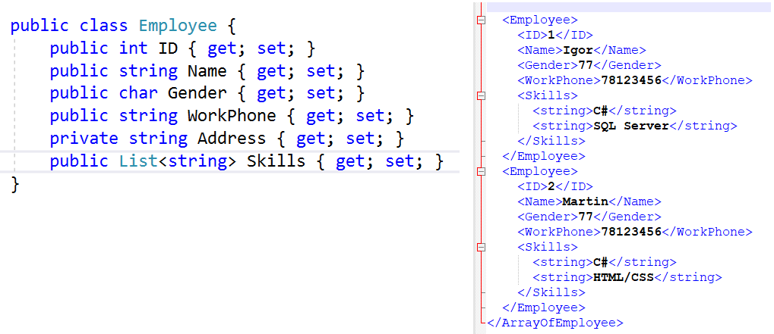
Example: without xml attributes

Slide 15
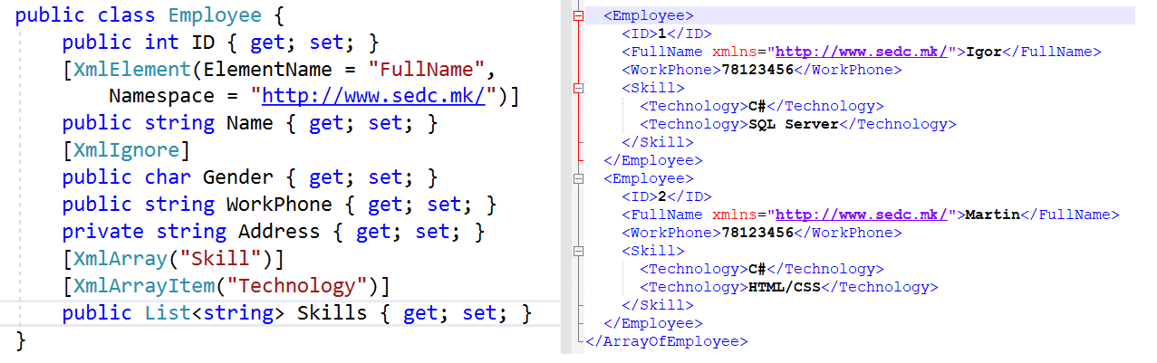
Example: with xml attributes

Slide 16
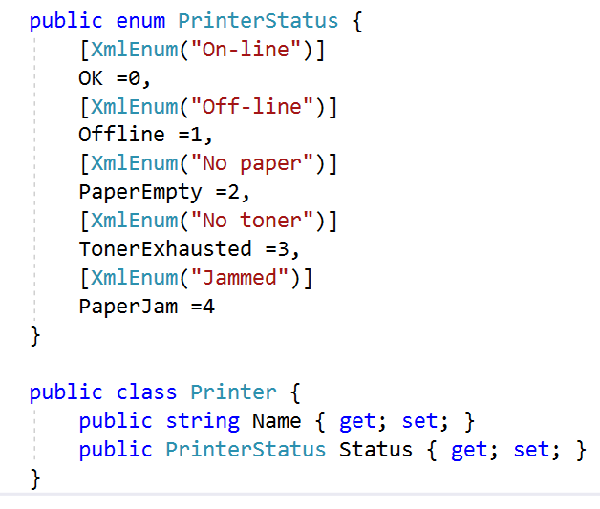
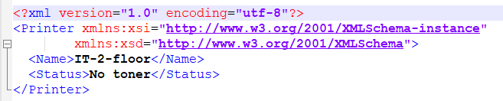
Example and Demo: XmlEnum serialization

Slide 17
Json serialization
The JsonSerializer converts .NET objects into their JSON equivalent and back again by mapping the .NET object property names to the JSON property names and copies the values for you.
The quickest method of converting between JSON text and a .NET object is using the JsonSerializer.
using Newtonsoft.Json;

Slide 18
Json attributes
Enum MemberSerialization:
OptOut: All public members are serialized by default. Members can be excluded using Newtonsoft.Json.JsonIgnoreAttribute or System.NonSerializedAttribute. This is the default member serialization mode.
OptIn: Only members marked with Newtonsoft.Json.JsonPropertyAttribute are serialized.
Fields: All public and private fields are serialized. Members can be excluded using Newtonsoft.Json.JsonIgnoreAttribute

Slide 19
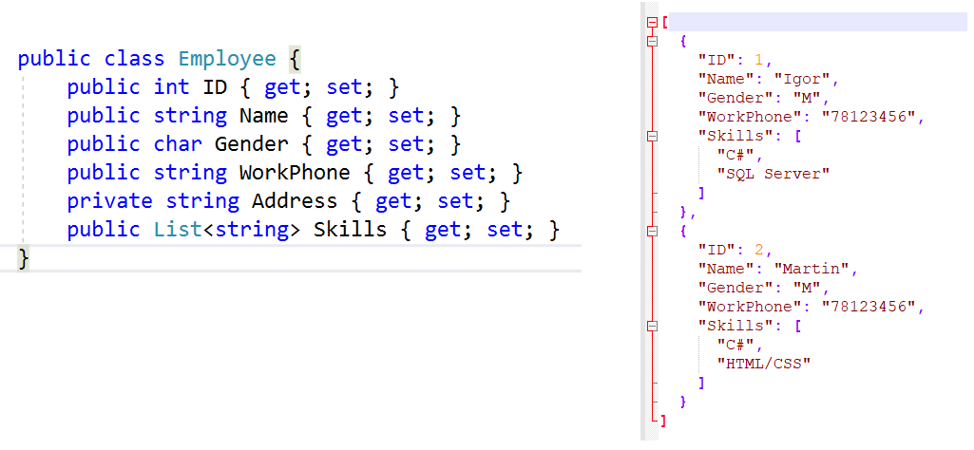
Example: json serialization

Slide 20
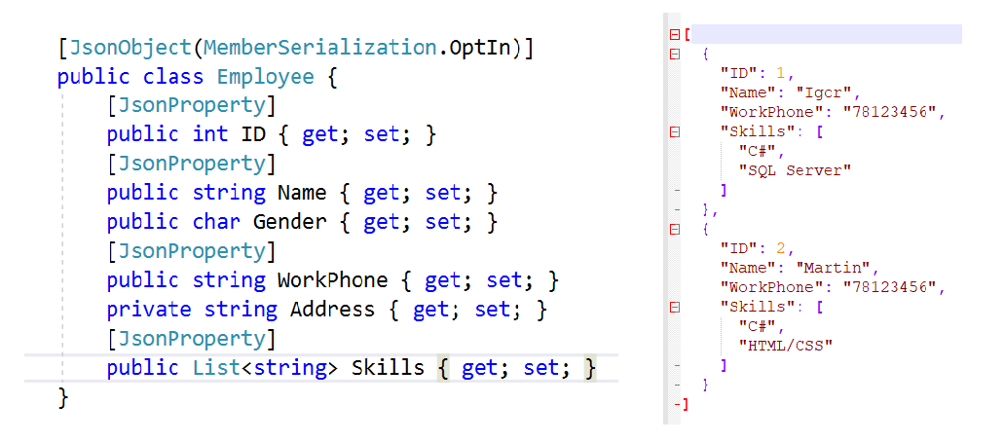
Example: json serialization with JsonProperty

Slide 21
Demo
Json serialization and deserialization with JsonProperty

Slide 22
Exercise JSON
Try with MemberSerialization.OptOut for the Employee class
Try with MemberSerialization.Fields for the Employee class

Slide 23
Discussion on serializations

Slide 24
Analysis of the serializations
https://maxondev.com/serialization-performance-comparison-c-net-formats-frameworks-xmldatacontractserializer-xmlserializer-binaryformatter-json-newtonsoft-servicestack-text/

